Slide 1
Car Price Prediction Using ML

Slide 2
INTRODUCTION
Objective :
Predict car prices using machine learning techniques to aid in the valuation of cars.
Help buyers and sellers make informed decisions by providing a reliable price estimation based on various car attributes.
Dataset:
CarPrice.csv containing car specifications, features, and prices.

Slide 3
challenges
Data Quality:
Missing values in columns and errors in categorical data.
Correcting typos in company names and ensuring consistency.
Feature Engineering:
Transforming categorical features into numerical formats.
Creating meaningful features from existing ones to enhance model performance.
Feature Selection:
Determining which features are most relevant for predicting car prices.
Balancing model complexity and interpretability.
Model Selection:
Choosing the right algorithms and tuning their hyperparameters for optimal performance.
Evaluating different models to find the best fit for the data.

Slide 4
METHODOLOGY
Data Cleaning:
Removed duplicate rows and handled missing values.
Corrected errors and inconsistencies in data.
Feature Engineering:
Encoded categorical variables using one-hot encoding.
Applied log transformation to skewed features like car price.
Exploratory Data Analysis (EDA):
Visualized distributions and relationships to understand data better.
Identified patterns and outliers.
Model Building:
Selected and trained multiple regression models to predict car prices.

Slide 5
DATA PREPROCESSING
Handling Missing Values:
Techniques used: Imputation or removal of missing data.
Feature Encoding:
One-hot encoding for categorical variables.
Conversion of text-based features to numerical values.
Feature Scaling:
Standardization of features using StandardScaler to ensure uniformity.
Dimensionality Reduction:
Applied Principal Component Analysis (PCA) to reduce the feature space.
Retained essential components to capture the most variance in the data.

Slide 6
Exploratory Data Analysis (EDA)
Histograms and Boxplots:
Analyzed the distribution of numerical features like price, horsepower, and engine size.
Detected outliers and skewness in the data.
Correlation Analysis:
Heatmap showing the correlation between features and price.
Identified strong correlations to understand feature importance.
Categorical Analysis:
Pie charts to visualize the distribution of categorical features like fuel type and car body type.

Slide 7
Model Selection and Training
Models Used:
Linear Regression: Basic model for comparison.
Decision Tree: Captures non-linear relationships.
Random Forest: Ensemble method for better accuracy.
Train-Test Split:
Data split into 70% training and 30% testing sets.
Ensured proper evaluation of model performance.

Slide 8

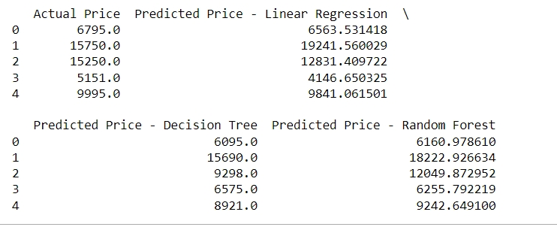
RESULTS
Model Performance:
Final Price Prediction:

Slide 9
WEB APPLICATION
Description:
The FastAPI web application is designed to provide users with an interactive platform for comparing car features and prices. This tool leverages the car price prediction model to help users understand how different cars stack up against each other based on various attributes.
Purpose:
The web application allows users to input names of two cars and visualize a side-by-side comparison of selected features such as price, engine size, horsepower, city MPG, and highway MPG.

Slide 10
Input Car Names:
Functionality: Users can enter the names of two cars into the provided text fields.
Validation: The application checks if the entered car names exist in the dataset. If either car name is not found, an error message is displayed.
Visual Comparison:
Bar Charts: After entering valid car names, the application generates bar charts comparing selected features of the two cars. Features compared include:
Price
Engine Size
Horsepower
City MPG
Highway MPG
Cylinder Number
Visualization:
Charts are dynamically created and displayed on the web page to provide a clear visual comparison between the two cars.

Slide 11
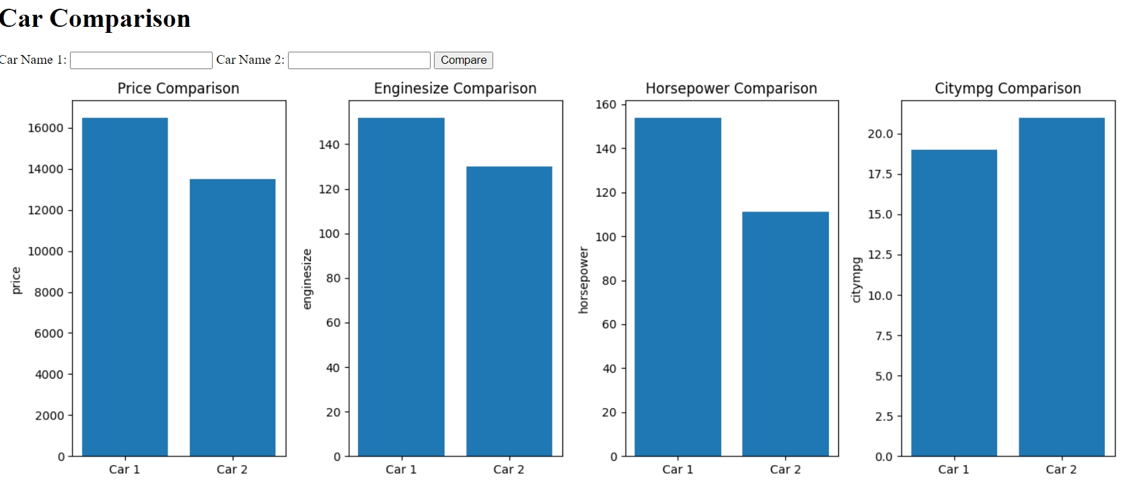
OUTPUT

Slide 12
CONCLUSION
Summary
Objectives Recap: This project aimed to predict car prices using a variety of machine learning algorithms. We processed and analyzed a dataset of car features and prices, implemented data preprocessing and scaling, and evaluated several regression models.
Methodology Recap: We employed several regression models including Linear Regression, Decision Tree, Random Forest. Data preprocessing involved handling missing values, feature encoding, standardization, and dimensionality reduction using PCA.
Key Findings: The Random Forest model outperformed other algorithms in terms of accuracy, indicating its effectiveness in capturing complex relationships in the data.
Insights
Model Performance: Random Forest achieved the highest accuracy, demonstrating its robustness in predicting car prices compared to other models. This highlights the model’s capability to handle a variety of feature interactions and non-linear relationships.
Feature Importance: The analysis revealed which features most significantly affect car prices, providing valuable insights into the factors that drive price variations.
Future Work
Feature Enhancement: Consider incorporating additional features or external datasets (e.g., car condition, location-specific trends) to improve the model’s accuracy.

Slide 13
THANK YOU

